Slide 1

Module Seven: Hot topics in Service Computing

Slide 2
Hot topics in Service Computing
In this module we will work both, in the classroom and at home
In the classroom
explore topics related to Cloud Computing
At home – 2 assignments
15% - Hot topic study journal – 3 tasks
10% - Exercises - Case study

Slide 3
Assignments deadlines
15% - Hot topic study journal – 3 tasks
Task 1 – March 26th
Task 2 – April 2nd
Task 3 – April 9th
10% - Exercises - Case study – April 16th

Slide 4
Hot topic study – 15%
Earlier in our course we have learnt some concepts by looking at a failure case.
In this activity, you will study the application of service orientation in the chosen domain/industry through success stories.

Slide 5
Hot topic study – 15%
Choose a domain/industry that you are interested to study
Complete 3 tasks that will help you to study the application of service orientation in the chosen domain/industry.

Slide 6
Assignments deadlines
15% - Hot topic study journal – 3 tasks
Task 1 – March 26th
Task 2 – April 2nd
Task 3 – April 9th
10% - Exercises - Case study – April 16th

Slide 7
Hot topic study – 15% → Task 1 (5%)
Find several cases and research papers on the use cases of service orientation in the chosen domain/industry (what problems did companies in this industry have that were solved by applying service orientation; what was the service orientation used for, … )
Submit a table with the information you have found
Make sure that the links you include are valid
Use case | Short description of the use case | Link to the website with the case description/research paper
Deadline: March 26th

Slide 8
Module Seven: Hot topics in Service Computing - Cloud -

Slide 9
Topic 1: Cloud Computing Overview

Slide 10
Intended learning outcomes
After completing this topic, you will:
Understand the concept and origins of cloud computing
Appreciate why cloud computing matters
Be aware of its disadvantages

Slide 11
Cloud computing definitions
What is cloud computing?
How would you define it?

Slide 12
Cloud computing definition (1)
Cloud computing is the delivery of different services through the Internet, which includes tools and applications like data storage, servers, databases, networking, and software.

Slide 13
Cloud computing definition (2)
Cloud computing is a general term for anything that involves delivering hosted services over the internet.
These services are divided into three main categories or types of cloud computing: infrastructure as a service (IaaS), platform as a service (PaaS) and software as a service (SaaS).

Slide 14
Cloud computing definition (3)
Cloud computing is the on-demand availability of computer system resources, especially data storage (cloud storage) and computing power, without direct active management by the user.
Large clouds often have functions distributed over multiple locations, each location being a data center.
Cloud computing relies on sharing of resources to achieve coherence and typically using a "pay-as-you-go" model which can help in reducing capital expenses but may also lead to unexpected operating expenses for unaware users.

Slide 15
There are other definitions in textbooks, research papers and online
They show different perspectives of cloud computing
You can study them if you are interested

Slide 16
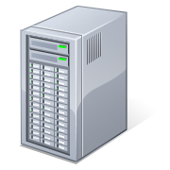
What is Cloud Computing
Shared pool of configurable computing resources
On-demand network access
Provisioned by the Service Provider
Applications
Services
Computer Network
Storage (Database)
SERvers

Slide 17
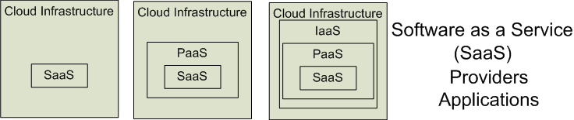

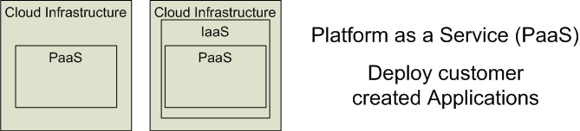
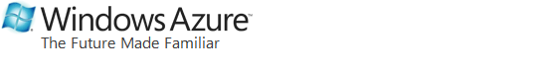
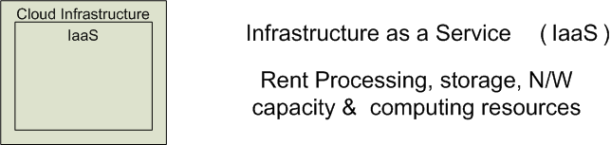


Cloud Service Models
Software as a Service (SaaS)
Platform as a Service (PaaS)
Infrastructure as a Service (IaaS)
SalesForce CRM
LotusLive
Google App Engine

Slide 18
Cloud deployment models (1)
Public clouds
Provide their services on servers and storage on the Internet.
These are operated by third-party companies, who handle and control all the hardware, software, and the general infrastructure.
Clients access services through accounts that can be accessed by just about anyone.
Private clouds
Are reserved for specific clientele, usually one business or organization.
The firm's data service center may host the cloud computing service.
Many private cloud computing services are provided on a private network.
Hybrid clouds
A combination of both public and private services.
This type of model allows the user more flexibility and helps optimize the user's infrastructure and security.

Slide 19
Cloud deployment models (2)
Community cloud
It allows systems and services to be accessible by a group of organizations
It is a distributed system that is created by integrating the services of different clouds to address the specific needs of a community, industry, or business
The infrastructure of the community could be shared between the organization which has shared concerns or tasks
It is generally managed by a third party or by the combination of one or more organizations in the community
Multi-cloud
Employing multiple cloud providers at the same time
It’s similar to the hybrid cloud deployment approach, which combines public and private cloud resources
Instead of merging private and public clouds, multi-cloud uses many public clouds
Improves availability of the services – when one cloud fails, another is available

Slide 20
Who uses cloud?
The short answer is: everyone.
From your phone and your car to your smart watch and your favorite food delivery app, the cloud is everywhere.
But cloud computing is especially powerful for businesses
Companies use it for routine tasks like
data protection
software development
data analytics
disaster recovery
virtual desktops
server virtualization
customer-facing applications

Slide 21
Cloud computing examples

Slide 22
Tencent Meeting & VooV Meeting
Tencent Meeting provides a cloud-based video conferencing solution that enables customers and users to host or join meetings anytime, anywhere.
Tencent Meeting is currently widely used in business, municipal services, finance, education, healthcare and other industries, and is available for online document signing, business solicitation, recruitment, online learning and training, and much more.
Its international version, VooV Meeting, has been launched in more than 100 countries and regions around the world.

Slide 23
Rain Classroom - 雨课堂
Rain Classroom is a cloud computing tool, which is jointly developed by Tsinghua University and XueTangX.
In 2018, XueTangX developed the virtual private cloud platform "XueTang Cloud" and the teaching tool "Rain Classroom" for assisting online learning.

Slide 24
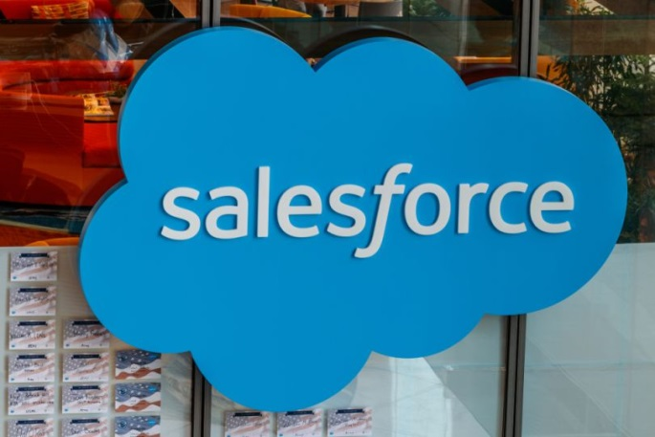
Salesforce
SaaS provider
CRM (customer relationship management) tool that helps businesses manage customer relations and generate sales leads.
The Sales Cloud combines A.I. and customer data to help sales teams identify potential leads and close sales faster.
The platform also has separate clouds for customer service and marketing.

Slide 25

AWS – Amazon Web Services
Amazon’s AWS (Amazon Web Services) has grown into the largest public cloud globally
It accounted for 38.9% of the IaaS market worldwide in 2021, according to Gartner
This section is also the largest profit source for Amazon
AWS Lambda lets developers run code for any application or backend service without provisioning or managing servers
The pay-as-you-go model continuously scales along with a business to accommodate for real-time shifts in data storage and usage

Slide 26
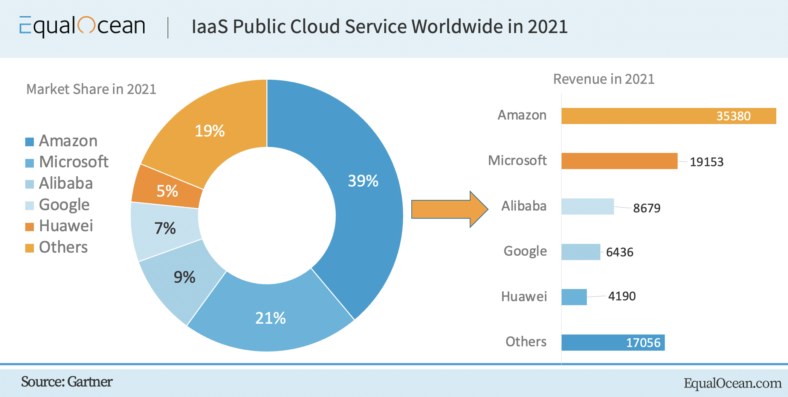

Slide 27
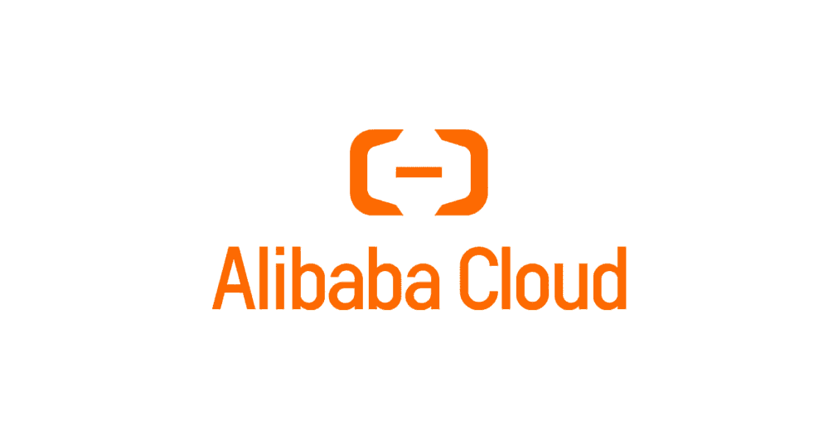
Alibaba Cloud 阿里云
The largest cloud computing company in China and in Asia Pacific
Offers cloud services that are available on a pay-as-you-go basis
elastic compute
data storage
relational databases
big-data processing
anti-DDoS protection
content delivery networks (CDN)
…

Slide 28
Cloud Computing Characteristics
Essential Characteristics:
On Demand Self-Service
Broad Network Access
Rapid Elasticity
Resource Pooling
Measured Service
Other Common Characteristics:
Massive Scale
Resilient Computing
Homogeneity
Geographic Distribution
Virtualization
Service Orientation
Low Cost Software
Advanced Security

Slide 29
Five essential characteristics of cloud computing
On-demand self-service
Broad network access
Resource pooling
Rapid elasticity
Measured service

Slide 30
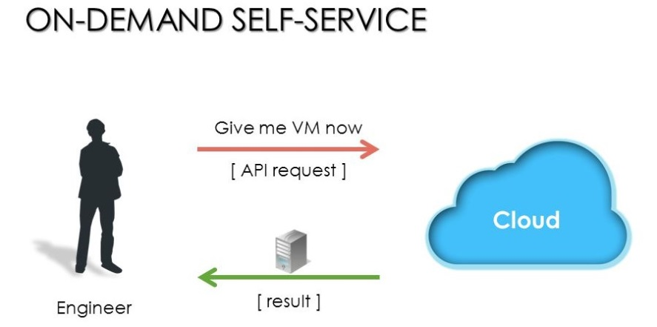
On-demand self-service
A consumer can automatically provision computing capabilities
“no-need-to-know” in terms of the underlying details of infrastructure, applications interface with the infrastructure via the APIs.

Slide 31
Five essential characteristics of cloud computing
On-demand self-service
Broad network access
Resource pooling
Rapid elasticity
Measured service

Slide 32
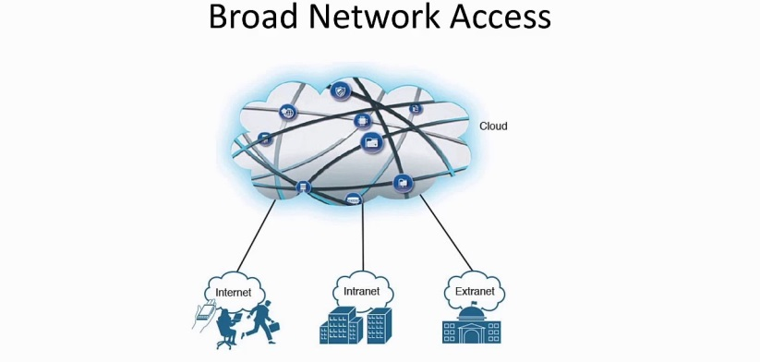
Broad network access
A user can access cloud data or upload data to the cloud from anywhere with an internet connection using any device.

Slide 33
Five essential characteristics of cloud computing
On-demand self-service
Broad network access
Resource pooling
Rapid elasticity
Measured service

Slide 34
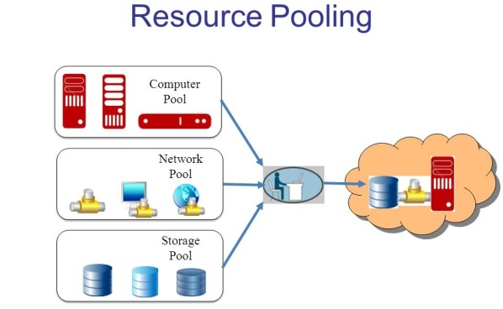
Resource pooling
Multi-tenant model lets numerous customers share the same physical infrastructures or the same applications yet still retain privacy and security over their own data.

Slide 35
Five essential characteristics of cloud computing
On-demand self-service
Broad network access
Resource pooling
Rapid elasticity
Measured service

Slide 36
Rapid elasticity
Capabilities can be elastically provisioned and released, in some cases automatically, to scale rapidly up and down commensurate with demand.
To the consumer, the capabilities available for provisioning often appear unlimited and can be appropriated in any quantity at any time.

Slide 37
Five essential characteristics of cloud computing
On-demand self-service
Broad network access
Resource pooling
Rapid elasticity
Measured service

Slide 38
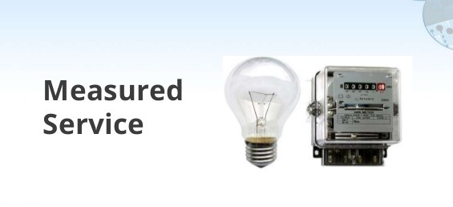
Measured service
Resource usage can be monitored, controlled, and reported, providing transparency for both the provider and consumer of the utilized service.
“pay as much as used and needed”

Slide 39
Five essential characteristics of cloud computing
On-demand self-service
Broad network access
Resource pooling
Rapid elasticity
Measured service

Slide 40
Cloud Computing Characteristics
Essential Characteristics:
On Demand Self-Service
Broad Network Access
Rapid Elasticity
Resource Pooling
Measured Service
Other Common Characteristics:
Massive Scale
Resilient Computing
Homogeneity
Geographic Distribution
Virtualization
Service Orientation
Low Cost Software
Advanced Security

Slide 41
Other characteristics
Scalability
Infrastructure capacity allows for traffic spikes and minimizes delays.
Resiliency
Cloud providers have mirrored solutions to minimize downtime in the event of a disaster. This type of resiliency can give businesses the sustainability they need during unanticipated events.
“always on!, anywhere and any place”
Homogeneity
No matter which cloud provider and architecture an organization uses, an open cloud will make it easy for them to work with other groups, even if those other groups choose different providers and architectures.

Slide 42
Cloud computing origin
Origin of the name
why “cloud”?
Origin of the technology
evolution of cloud computing

Slide 43
Cloud computing origin
Origin of the name
why “cloud”?
Origin of the technology
evolution of cloud computing

Slide 44

What is “cloud”?

Slide 45
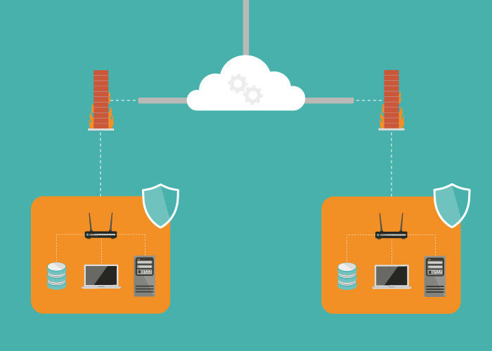
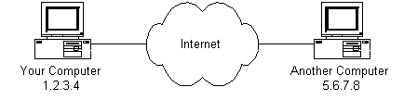
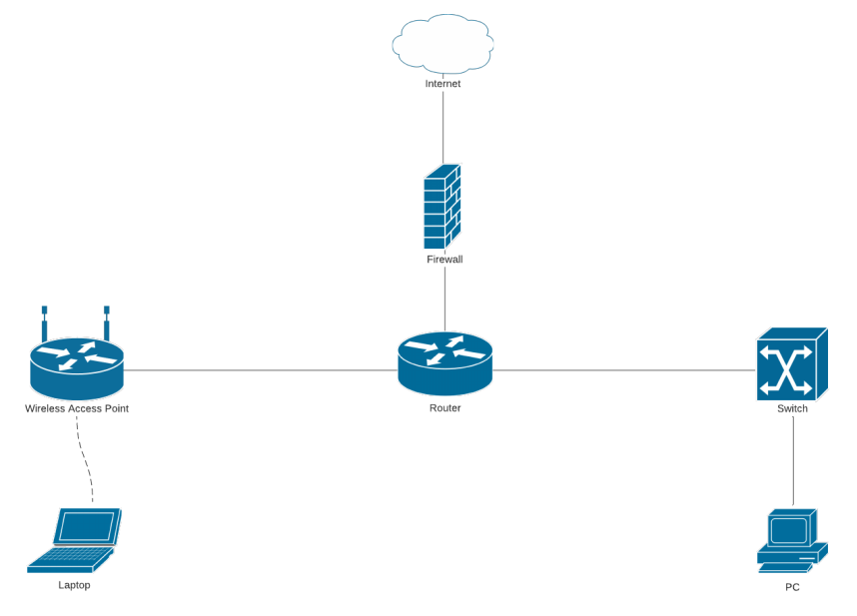
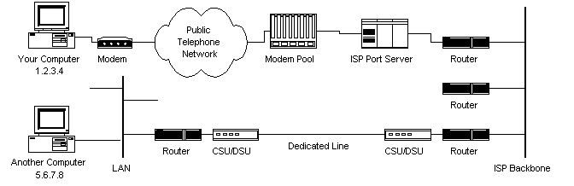
What symbol is used to represent the Internet in these flow charts and diagrams?

Slide 46
Cloud as a symbol of Internet
Recall our definition of cloud computing
Cloud computing is a general term for anything that involves delivering hosted service over the Internet
The name “cloud computing” was inspired by the cloud symbol that’s often used to represent the Internet in flow charts and diagrams

Slide 47
Cloud as a symbol of Internet in diagrams

Slide 48
Cloud as a symbol of Internet in diagrams

Slide 49

Cloud as a symbol of Internet in diagrams

Slide 50
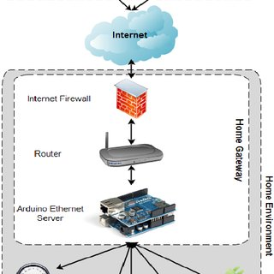
Cloud as a symbol of Internet in diagrams

Slide 51
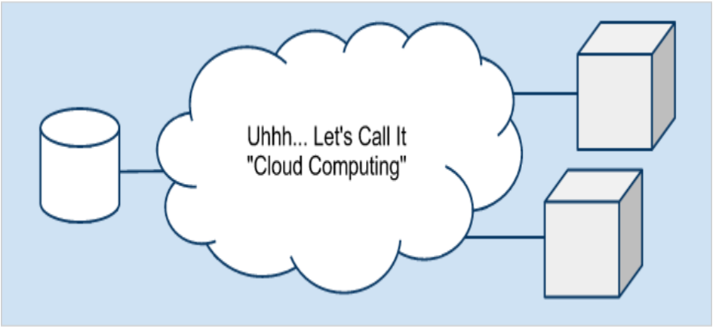
Cloud as a symbol of Internet in diagrams
One relevant quote " Cloud comes from the early days of Internet where we drew the network as a cloud... we didn't care where the message went- the cloud hid it from us " , Kevin Marks, Google Engineer

Slide 52

Cloud as a metaphor for virtual space
In cloud computing, the information being accessed is
found remotely in the cloud or a virtual space.
Companies that provide cloud services enable users to store files and applications on remote servers and then access all the data via the Internet.
This means the user is not required to be in a specific place to gain access to it, allowing the user to work remotely.
That virtual space becomes the cloud —your data, work, and applications are available from any device with which you can connect to the Internet, anywhere in the world.

Slide 53
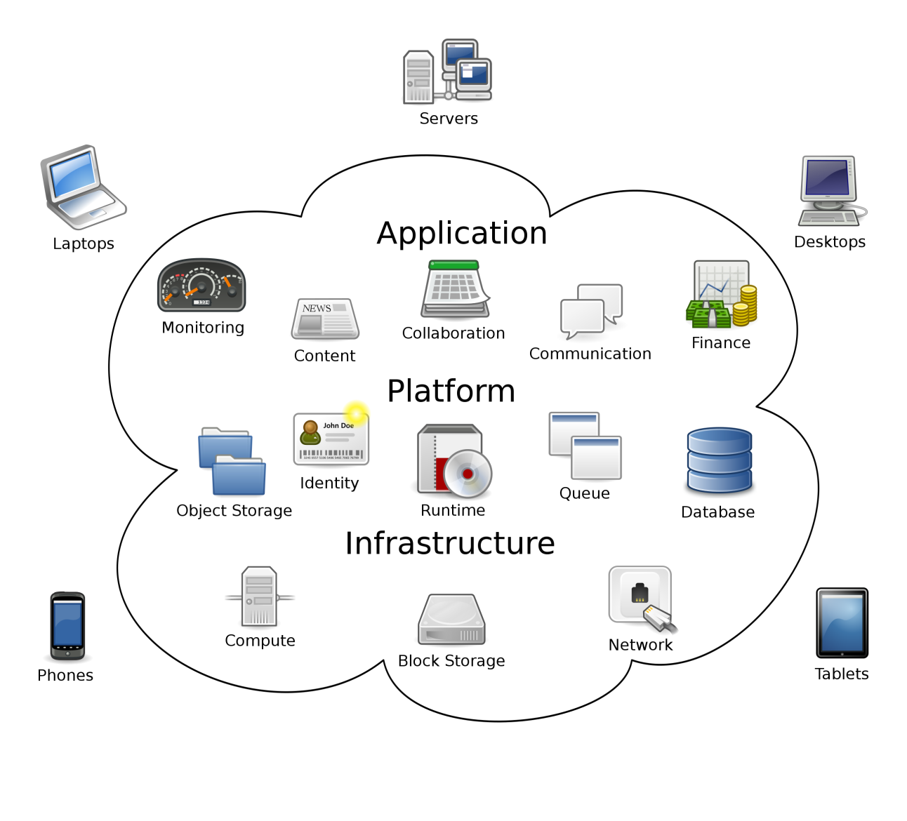
Cloud as a metaphor for virtual space (2)
Cloud computing metaphor: the group of networked elements providing services need not be individually addressed or managed by users; instead, the entire provider-managed suite of hardware and software can be thought of as an amorphous cloud
amorphous - without a clearly defined shape or form

Slide 54
Cloud computing origin
Origin of the name
why “cloud”?
Origin of the technology
Evolution of cloud computing

Slide 55
Evolution of cloud computing
These technologies contributed to the making of cloud computing:
Time sharing
Global network
Virtualization
Web applications
Web services
…
Apart from the above, other trends and technologies contributed to the development of cloud computing as well. You can read about them online and find research papers

Slide 56
Time sharing
In the 1950s, companies started to use large mainframe computers, but it was too expensive to buy a computer for each user.
So, during the late 1950s and early 1960s, a process called time sharing was developed to make more efficient use of expensive processor time on the central mainframe.
Time sharing enabled users to access numerous instances of computing mainframes simultaneously, maximizing processing power and minimizing downtime.
This idea represents the first use of shared computing resources, the foundation of modern cloud computing.

Slide 57
Global network
The origins of delivering computing resources using a global network are rooted in 1969 when American computer scientist J.C.R. Licklider helped create the Advanced Research Projects Agency Network, the so-called precursor to the Internet.
Licklider's goal was to connect computers across the globe in a way that would enable users to access programs and information from any location.I

Slide 58
Virtualization
It refers to the process of creating a virtual layer over the hardware which allows the user to run multiple instances simultaneously on the hardware.
In the 1970s, cloud computing began taking a more tangible shape with the introduction of the first VMs (virtual machines), enabling users to run more than one computing system within a single physical setup.
The functionality of these VMs led to the concept of virtualization, which had a major influence on the progress of cloud computing.
It is the base on which major cloud computing services such as Amazon EC2, VMware vCloud, etc work on. Hardware virtualization is still one of the most common types of virtualization.

Slide 59
Web Applications
In the 1970s and 1980s, Microsoft, Apple and IBM developed technologies that enhanced the cloud environment and advanced the use of the cloud server and server hosting.
Then, in 1999, Salesforce became the first company to deliver business applications from a website.

Slide 60
Web Services
In 2006, Amazon launched AWS, providing such services as computing and storage in the cloud
Simple Storage Service (S3)
Elastic Compute Cloud (EC2)
These products pioneered the usage of server virtualization to deliver IaaS at a cheaper and on-demand pricing basis.
Following suit, the other major tech players, including Microsoft and Google, subsequently launched their own cloud offerings to compete with AWS

Slide 61
Cloud computing advantages
Cost savings
Increased productivity
Business continuity and disaster recovery

Slide 62
Cloud computing advantages

Slide 63
Cloud computing advantages
Cost savings
Increased productivity
Business continuity and disaster recovery

Slide 64

Cost savings
Money
Time

Slide 65

Money savings
Minimize up-front IT infrastructure costs
Minimize hardware cost
Minimize software cost
Minimize operational cost
Minimize downtime cost
…

Slide 66
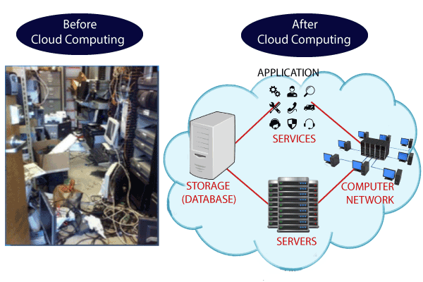
Minimize up-front IT infrastructure costs (1)
Companies can swap costly server centers and IT departments for fast Internet connections, where employees interact with the cloud online to complete their tasks.

Slide 67
Minimize up-front IT infrastructure costs (2)
Before cloud computing
Companies were required to purchase, construct, and maintain costly information management technology and infrastructure - server centres
a database server, mail server, networking, firewalls, routers, modem, switches, QPS (Query Per Second means how much queries or load will be handled by the server), configurable system, high net speed,
the maintenance engineers

Slide 68
Minimize up-front IT infrastructure costs (2)
After cloud computing
They don't have to invest in hardware, facilities, utilities or building large data centers to accommodate their growing businesses.
Companies don't need large IT teams because they can rely on the expertise of their cloud providers' teams.

Slide 69
Minimize hardware cost
Traditional desktop software runs on desktop PC and demands high processing power and hard disk space– costly
Running cloud computing’s web-based applications does not require a high-powered and high-priced computer
PC can be less expensive, with a smaller hard disk, less memory, more efficient processor...

Slide 70
Minimize software cost
Instead of purchasing expensive software applications, companies can get most of wheat they need in the cloud
Many cloud computing applications are available for free
Instant software updates without high upgrade costs
When the application is web-based, updates happen automatically available the next time you log into the cloud
When you access a web-based application, you get the latest version without needing to pay for or download an upgrade

Slide 71
Minimize downtime cost
Cloud computing also cuts costs related to downtime
Downtime - the time during which a computer or IT system is unavailable, offline or not operational
Since downtime rarely happens in cloud computing, companies don't have to spend time and money to fix any issues that might be related to downtime

Slide 72

Time savings
Minimize application development time
Minimize management time
…

Slide 73
Minimize application development time
Cloud computing allows enterprises to get their applications up and running faster, with improved manageability and less maintenance

Slide 74
Minimize management time
Cloud computing enables IT teams to more rapidly adjust resources to meet fluctuating and unpredictable demand providing burst computing capability: high computing power at certain periods of peak demand.

Slide 75
Increased productivity
Improved data storage
Data and workload mobility
Improved collaboration

Slide 76
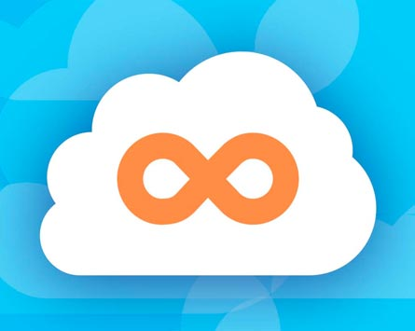
Improved data storage
Unlimited storage capacity
Cloud computing offers virtually limitless storage.
Increased data reliability
Even if your personal computer crashes, all your data is still out there in the cloud, still accessible

Slide 77

Data and workload mobility
Storing information in the cloud means that users can access it from anywhere with any device with just an internet connection
Remote employees are able to stay up to date with co-workers and customers

Slide 78

Improved collaboration (1)
Shared storage:
Sharing documents leads directly to better collaboration
Multiple users can collaborate easily on documents and projects
Colleagues can work together on documents housed in the cloud, with everyone able to access the same files and edit them in real-time.

Slide 79
Improved collaboration (2)
Improved document format compatibility.
You do not have to worry about the documents you create on your machine being compatible with other users' applications or OSes
There are potentially no format incompatibilities when everyone is sharing documents and applications in the cloud.

Slide 80
Improved collaboration (3)
Document version management
Cloud collaboration eliminates the confusion caused by having multiple versions of the same documents or the trials of attempting to merge resulting files

Slide 81
Improved collaboration (4)
Space and time decoupling
Cloud computing enables teams to work together and achieve their shared goals without being together physically in the workplace
Team members can view and edit the documents at any time

Slide 82
Business continuity and disaster recovery
All organizations worry about data loss. Storing data in the cloud guarantees that the data can be recovered even if
their local devices, e.g., laptops or smartphones, are inoperable
in the event of emergencies, such as natural disasters or power outages

Slide 83
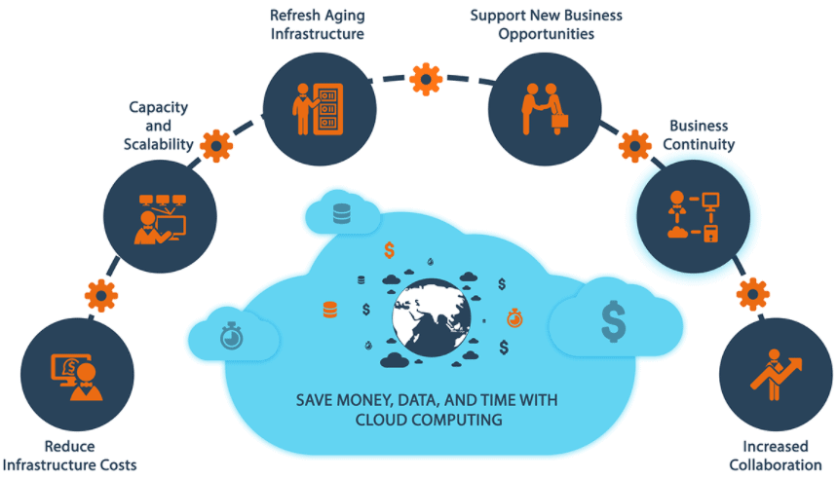

Slide 84
Cloud computing disadvantages

Slide 85
Cloud computing disadvantages
Cloud security
Cloud performance
Limited customization options
Cost unpredictability
Lack of capability and expertise
Compliance with industry laws
Complicated cloud migration
IT governance issues
Vendor lock-in

Slide 86
Cloud security
Security is often considered the greatest challenge facing cloud computing, especially when it comes to sensitive medical records and financial information.
When relying on the cloud, organizations risk
data breaches
hacking of APIs and interfaces
compromised credentials
authentication issues
Furthermore, there is a lack of transparency regarding how and where sensitive information entrusted to the cloud provider is handled.
Security demands careful attention to cloud configurations and business policy and practice.

Slide 87
Cloud performance
Performance -- such as latency -- is largely beyond the control of the organization contracting cloud services with a provider.
Network and provider outages can interfere with productivity and disrupt business processes if organizations are not prepared with contingency plans.

Slide 88
Limited customization options
Cloud computing is cheaper because of economics of scale, but it offers fewer options at a much cheaper price
A restaurant with a limited menu is cheaper than a personal chef who can cook anything you want

Slide 89
Cost unpredictability
Pay-as-you-go subscription plans for cloud use, along with scaling resources to accommodate fluctuating workload demands, can make it tough to predict final costs

Slide 90
Lack of capability and expertise
With cloud-supporting technologies rapidly advancing, organizations are struggling to keep up with the growing demand for tools and employees with the proper skill sets and knowledge needed to architect, deploy, and manage workloads and data in a cloud.

Slide 91
Compliance with industry laws
When transferring data from on-premises local storage into cloud storage, it can be difficult to manage compliance with industry regulations through a third party.
It's important to know where data and workloads are actually hosted in order to maintain regulatory compliance and proper business governance.

Slide 92
Complicated cloud migration
The process of moving applications and other data to a cloud infrastructure often causes complications
Migration projects frequently take longer than anticipated and go over budget

Slide 93
IT governance issues
Cloud infrastructure is completely owned, managed, and monitored by the service provider, so the cloud users have less control over the function and execution of services within a cloud infrastructure.
This can make it challenging to properly manage risks and security, IT compliance and data quality.

Slide 94
Vendor lock-in
Often, switching between cloud providers can cause significant issues.
technical incompatibilities
legal and regulatory limitations
substantial costs incurred from sizable data migrations

Slide 95
Summary (1)
Cloud computing is the delivery of different services through the Internet
The service types include software, infrastructure, platform and many others
They can be deployed in private clouds and public clouds, as well as their combination

Slide 96
Summary (2)
Cloud computing offers its users many advantages, but it also has disadvantages and there is an ongoing research to solve these problems

